Slide 1
PROXIMITY SENSORS

Slide 2
What is a Proximity Sensor?
A proximity sensor is a sensor able to detect the presence of nearby objects without any physical contact
Proximity sensors detect the presence or absence of objects using electromagnetic fields, light, and sound.

Slide 3
How does it work?
A proximity sensor often emits an electromagnetic field or a beam of electromagnetic radiation (infrared, for instance), and looks for changes in the field or return signal.
The object being sensed is often referred to as the proximity sensor's target. Different proximity sensor targets demand different sensors.
For example, a capacitive proximity sensor or photoelectric sensor might be suitable for a plastic target; an inductive proximity sensor always requires a metal target.

Slide 4
Types of Proximity Sensors?
Capacitive Proximity Sensor.
Inductive Proximity Sensor.
Magnetic Proximity Sensor.
Optical Proximity Sensor.
Ultrasonic Proximity Sensor.

Slide 5
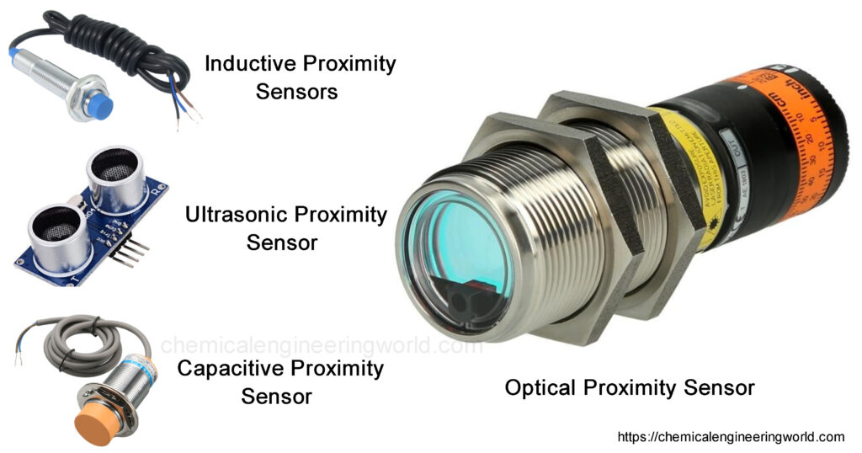

Slide 6
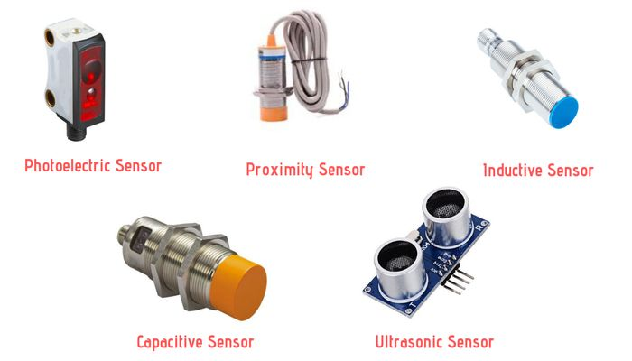

Slide 7
INDUCTIVE
An inductive proximity sensor can only detect metal targets.
This is because the sensor utilizes an electromagnetic field.
When a metal target enters the electromagnetic field, the inductive characteristics of the metal change the field’s properties, thereby alerting the proximity sensor of the presence of a metallic target.
Depending on how inductive the metal is, the target can be detected at either a greater or shorter distance.
This sensor operate under the electrical principal of inductance; where a fluctuating current induces an EMF in a target object.

Slide 8
CAPACITIVE
These proximity sensors are capable of detecting anything that can carry an electrical charge.
Capacitive sensors are commonly used in liquid-level detection. Possible targets for capacitive sensors include but are but not limited to: glass, plastic, water, wood, metals, and a myriad of targets of other materials.

Slide 9
PHOTOELECTRIC
There are two main types of photoelectric proximity sensors: reflective and through-beam.
Reflective proximity sensors detect objects when the light emitted from the sensor is reflected back at the photoelectric receiver.
Through-beam sensors detect targets when the target breaks the beam of light between the sensor’s emitter and receiver.

Slide 10
MAGNECTIC AND ULTRASONIC
Magnetic proximity sensors are only used to detect permanent magnets.
Ultrasonic proximity sensors emit a high pitch sound. The distance between the sensor and the target is determined by how long the sound takes to reflect back to the sensor.

